Slide 1
Intro and QM Postulates Summary
CBE 66697
Gray Laughlin

Slide 2
Lecture 0 - What Questions can QM Address?
What are we interested in knowing?
Shapes and properties of atoms and molecules
Macroscopic properties of materials
Reactivity between chemical species
Energy released and consumed by chemical reactions
Computational Tools:
Schrödinger equation
Density Functional Theory (DFT)
Molecular Dynamics

Slide 3
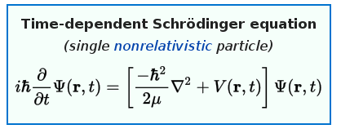

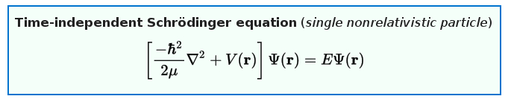
Lecture 1 - The Schrödinger Equation
Eigenvalue problem in which Ĥ acts on the wavefunction.
Kinetic and Potential Energy Operators

Slide 4
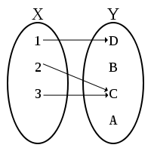
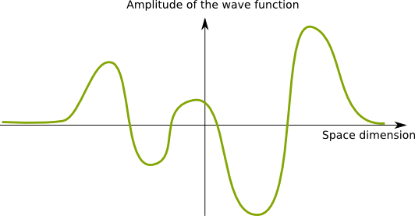
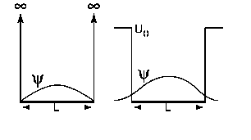

Lecture 1 - Postulates of QM
The physical state of a system is completely described by its wavefunction.
Physical Requirements for Ψ:
Continuous and twice differentiable
Single-Valued
Boundary Conditions are Satisfied
Square-Integrable

Slide 5
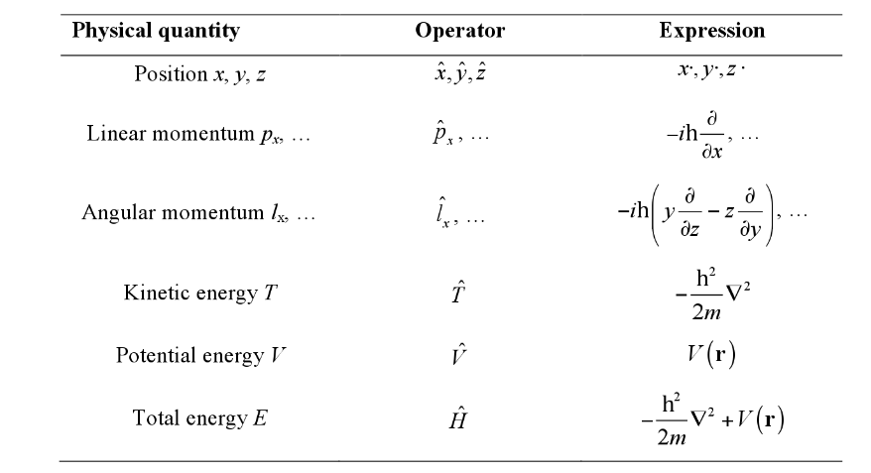
Lecture 1 - Postulates of QM
2. For all observable quantities (position, momentum, energy), there corresponds a linear quantum mechanical operator.

Slide 6


Lecture 1 - Postulates of QM
3. The expectation value of an observable can be computed with the wavefunction of the system and the operator of the observable.
4. Eigenvalues of the Schrödinger equation are energy-invariant states of the system.
Energy Operator

Slide 7

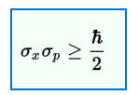
Lecture 1 - Postulates of QM
5. Quantum mechanical operators that do not commute correspond to observables that cannot both be exactly specified at the same time.
Heisenberg’s Uncertainty Principle:
Definition of Commutator:
Commutator of position and momentum:

